Slide 1
BIG BAZAAR
OBJECTIVE :-
As an employee of Big Bazaar Advertisement team, I want to select the best 10 Company who are interested in Big Bazaar Online and Offline Advertisement which could be helpful for Big Bazaar and the supplier company.

Slide 2
Description of the objective?
Ads Campaign
Suppliers
How the ads benefits suppliers?
Big Bazaar
Why are this 10 suppliers preferred more than others?
What are the possible ways to generate good outcomes?
What if it doesn't work?
What is the major factor which can lead me to more sales and how advertise does that?
How much my sales will be increasing?
Does any of the suppliers from this 10 are compititors?
How much benefits we will get as we advertise their brand?
What is in it for the customers?

Slide 3
How do ads benefit suppliers?
Hypothesis Testing:
H0: Ads have no impact on supplier performance (sales, customer engagement).
H1: Ads improve supplier performance (sales, customer engagement).
Statistical Test: Conduct a T-test or ANOVA to compare the sales before and after running ads for suppliers.
Metrics to Track: Sales data, customer feedback, brand awareness, ROI.

Slide 4
What are the possible ways to generate good outcomes?
To analyze multiple variables that might influence outcomes (e.g., ad spend, ad type, target audience).
Correlations: Measure the relationship between ad targeting, frequency, and sales increase.
Hypothesis:
H0: There is no relationship between ad targeting and sales outcomes.
H1: There is a positive relationship between ad targeting and sales outcomes.

Slide 5
What if it doesn't work?
Failure Analysis: If ads don't work, analyze the data to identify failure patterns (e.g., poor ad type, wrong targeting).
Chi-Square Test: To test if certain factors (ad type, targeting method) correlate with a "failure" outcome (e.g., no increase in sales).
Metrics to Track: Sales drop, ROI below threshold, customer engagement below expectations.

Slide 6
What is the major factor which can lead me to more sales and how does advertising achieve that?
Regression Analysis: Perform a multiple regression to understand the impact of multiple factors on sales (ad spend, product types, ad medium).
Hypothesis:
H0: There is no major factor that drives sales.
H1: Certain factors (e.g., ad spend or ad targeting) significantly drive sales.
Metrics: Correlation between ad spend and sales increase, ad targeting precision, customer conversion rates.

Slide 7
How much will my sales increase?
Time Series Analysis: Analyze past sales data before and after advertising to estimate the potential increase in sales.
Regression Analysis: Use a regression model to predict sales based on advertising data.
Metrics: Sales increase percentage, ROI, customer acquisition rate.
Objective
Structure
Category justify
Advertisement how many types and how it help why this advertisement is used for this
Solutioninging connecting suppliers and big bazaar
Compare the suppliers (converstion , marketing, etc)
How to do this

Slide 8
Metrics Explanation for Suppliers
Metric | Description | How It Benefits Suppliers
Sales Growth (%) | The percentage increase in sales before and after the ad campaign. | Indicates the direct impact of ads on supplier sales.
Brand Awareness (Survey Score) | Customer perception of the supplier’s brand before and after ads. | Measures how well the ad campaign improved supplier brand recognition.
Customer Engagement Rate (%) | The percentage of customers interacting with the supplier’s ads or promotions. | Reflects the ad's ability to engage customers, leading to higher conversions.
Ad Spend vs. Sales Growth | The relationship between the ad budget allocation and resulting sales increase. | Determines the efficiency of ad spend in driving sales.
Ad Type Performance (TV, Digital, etc.) | Comparison of sales growth based on different types of advertisements. | Identifies which ad types yield the best results for suppliers.
Customer Satisfaction Score | Feedback from customers on supplier products and overall experience. | Measures customer satisfaction after engaging with the ad campaign.
Conversion Rate (%) | The percentage of ad viewers who make a purchase. | Indicates the effectiveness of the ads in converting views into purchases.
Product Quality Ratings (Survey) | Ratings or reviews based on the quality of the supplier's products. | Helps suppliers understand how product quality correlates with ad effectiveness.
ROI (Return on Investment) | Measures the return on investment for the ad spend. | Determines the financial benefit to the supplier relative to the ad budge

Slide 9
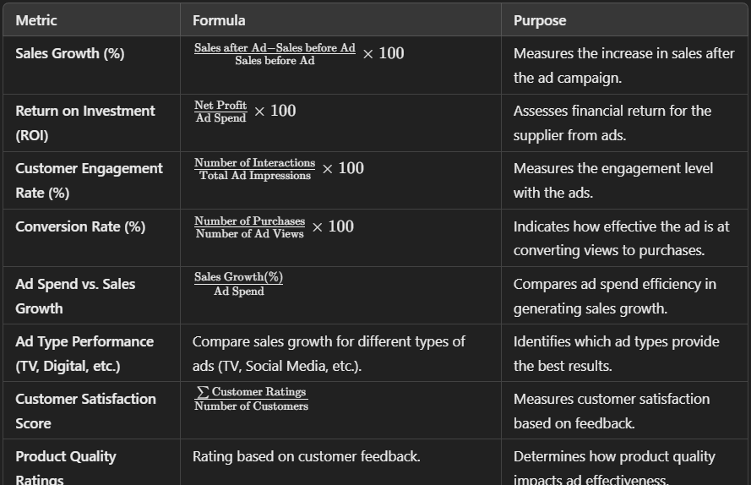
Important calculation for Supplier

Slide 10
Why are these 10 suppliers preferred more than others?
Descriptive Statistics: Calculate the mean, median, and mode for supplier performance metrics like sales, customer satisfaction, or pricing.
Factor Analysis: Identify the key factors that make these suppliers preferred (e.g., quality, price, availability).
Hypothesis:
H0: The preference for these suppliers is random.
H1: There are specific factors (e.g., pricing, product quality) that make these suppliers preferred.
Metrics: Supplier performance, customer reviews, sales data, market share.

Slide 11
Does any of the suppliers from these 10 compete?
Cluster Analysis: Use K-means clustering to identify suppliers that offer similar products and thus are in competition.
Correlation: Test the correlation between sales and product category to identify competitors.
Metrics: Sales in similar product categories, product overlap.

Slide 12
How much benefits will we get as we advertise their brand?
Regression Analysis: Analyze the relationship between advertising spend and the resulting sales increase for Big Bazaar.
Hypothesis:
H0: Advertising supplier brands does not significantly affect Big Bazaar's sales.
H1: Advertising supplier brands significantly increases Big Bazaar’s sales.
Metrics: Sales growth for Big Bazaar, ROI, customer traffic.

Slide 13
What is in it for the customers?
Customer Segmentation: Use clustering to segment customers based on their responses to ads (engaged vs. non-engaged).
Surveys & Feedback: Use Likert scale surveys to assess customer satisfaction with advertised products.
Hypothesis:
H0: Ads do not significantly affect customer satisfaction or behavior.
H1: Ads increase customer satisfaction and encourage more purchases.
Metrics: Customer satisfaction, sales conversion, product preference.

Slide 14
Metrics Explanation for Big bazaar
Metric | Description | How It Benefits Big Bazaar
Increased Traffic to Website (%) | Percentage increase in traffic to Big Bazaar's online platform due to supplier ads. | Reflects how supplier ads are driving more customers to Big Bazaar.
Sales Growth (%) | Percentage increase in sales for Big Bazaar as a result of supplier ads. | Measures the sales impact on Big Bazaar from advertising supplier brands.
Customer Satisfaction Score | Feedback on the overall customer experience, including ads and product availability. | Indicates the impact of advertising on customer experience at Big Bazaar.
Supplier Brand Recognition Impact (%) | The change in awareness of supplier brands within Big Bazaar's customer base. | Measures the success of advertising campaigns in raising supplier brand awareness.
Customer Conversion Rate (%) | The percentage of customers who make a purchase after interacting with supplier ads. | Shows how well Big Bazaar’s customers are converting after ad exposure.
ROI for Big Bazaar | Return on investment for Big Bazaar from advertising supplier brands. | Evaluates how much profit Big Bazaar makes from ads that promote supplier brands.
Product Availability (In-store/Online) | The availability of products at Big Bazaar after ad campaigns. | Ensures customers can purchase the products they see in the ads.
Ad Spend vs. Sales Growth | Comparison of ad budget spent on supplier ads vs. resulting sales growth for Big Bazaar. | Determines the cost-effectiveness of the ad campaigns for Big Bazaar.
Customer Traffic & Engagement from Ads | Measures the increase in customer traffic and interactions with ads. | Shows the level of customer interest and engagement due to the ads.

Slide 15
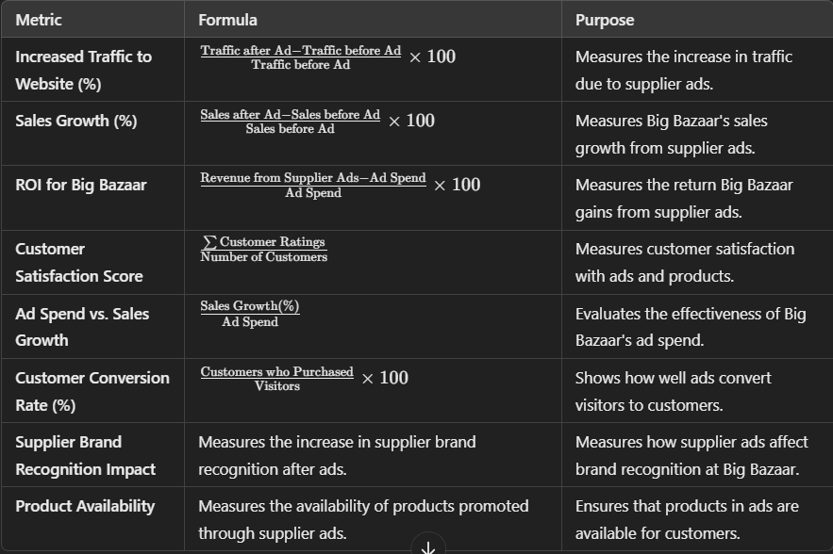
Important Calculation for Big Bazaar

Slide 16
Strategy for Business
Define campaign goals.
Segment suppliers by product category.
Assess supplier performance and customer demand.
Consider supplier reputation and brand alignment.
Evaluate supplier digital presence and capabilities.
Analyze cost and ROI potential.
Target geographically relevant suppliers.
Collaborate closely with suppliers willing to support campaigns.
Choose appropriate ad channels for each supplier.
Track and measure campaign results to optimize future strategies.
Establish clear marketing objectives (brand awareness, sales growth, market expansion).

Slide 17
Variables needed for the Objectives
Data Collection
Sales figures
Ad Data
Ad spend
Customer Data
Purchase behavior
Demographics
ad engagement
satisfaction levels
ad types
target audience
ad frequency
product categories
brand recognition metrics
Supplier Data

